Slide 1


RELATIONAL MODEL TOUROPERATOR
FERNANDO MUÑOZ RAMIREZ
RUBÉN NAVARRO TRUJILLO
INMACULADA VALERO FRIAS

Slide 2
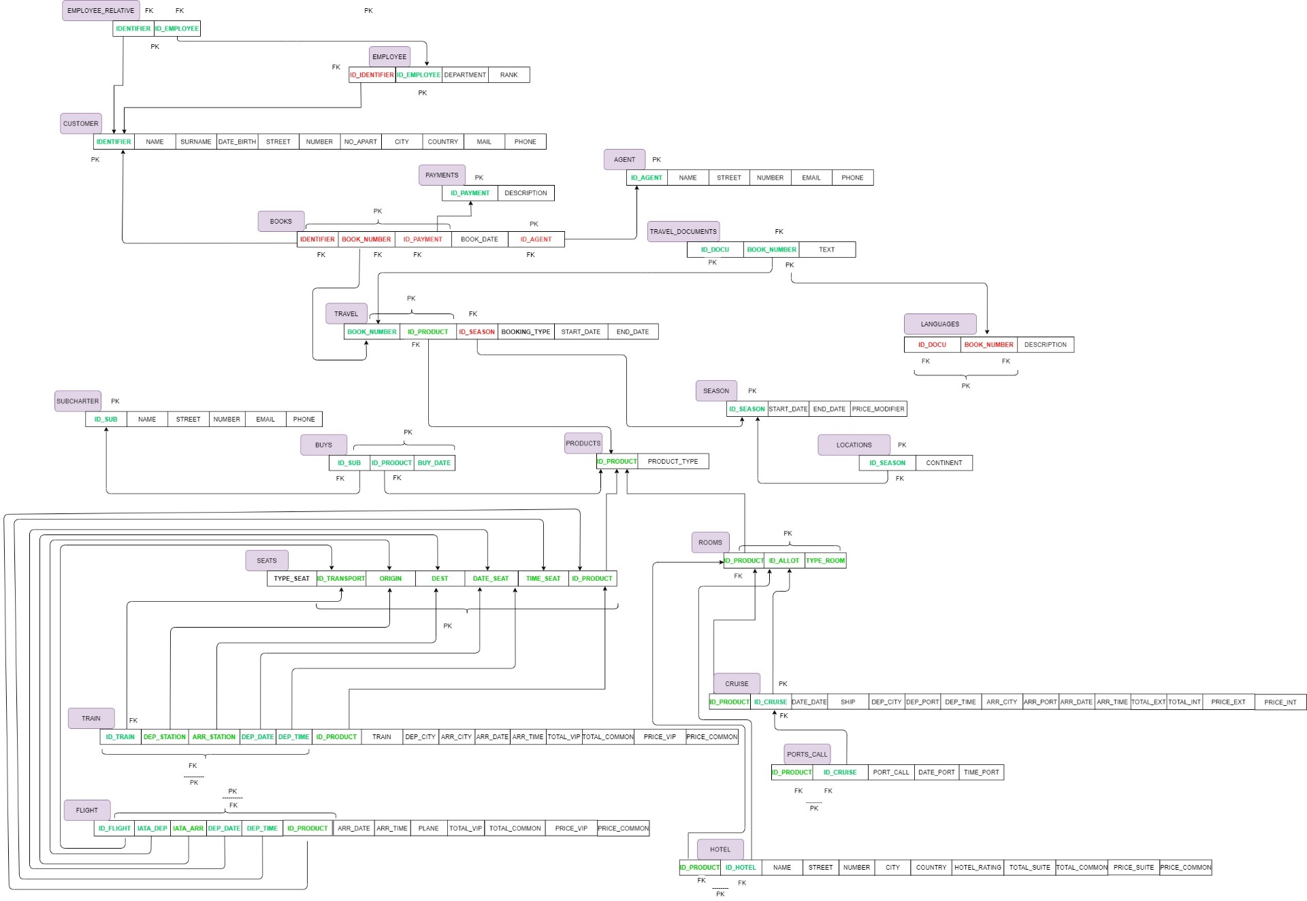
RELATIONAL MODEL TOUROPERATOR
PRIMARY KEY
FOREIGN KEY

Slide 3
DESIGN DEVELOPMENT
Employee_Relative
PK -> Identifier,ID_Employee
FK -> Identifier, ID_Employee
Travel
PK -> Book_number, ID_Prodcut
FK -> ID_Product, ID_Season, Booking_type
Employee
PK -> ID_Employee
FK -> ID_Identifier
Travel_Documents
PK -> Book_number, ID_Docu
FK -> Book_Number
Customer
PK -> Identifier
Languages
PK -> ID_Docu, Book_Number
FK -> ID_Docu, Book_Number
Agents
PK -> ID_Agent
Product
PK -> ID_Prodcut
Books
PK -> Identifier, Book_number, ID_Payment, ID_Agent
FK -> Identifier, Book_number, ID_Payment, ID_Agent
Season
PK -> ID_Prodcut
Locations
PK -> ID_Season
FK -> ID_Season
Payments
PK -> ID_Payment

Slide 4
Buys
PK -> ID_Prodcut, ID_Sub, Buy_Date
FK -> ID_Prodcut, ID_Sub
Rooms
PK -> ID_Product, ID_Allot, Type_Room
FK -> ID_Product
Subcharter
PK -> ID_Sub
Cruise
PK -> ID_Cruise, ID_Product
FK -> ID_Cruise, ID_Product
Seats
PK -> Type_Seat, ID_Transport, Origin_Dest, Date_Seat, Time_Seat, ID_Product
Hotel
PK -> ID_Hotel, ID_Product
FK -> ID_Hotel, ID_Produc
Train
PK -> ID_Train, Dep_Station, Arr_Station, Dep_Date, Dep_Time, ID_Product
FK -> ID_Train, Dep_Station, Arr_Station, Dep_Date, Dep_Time, ID_Product
Port_Calls
PK -> ID_Cruise, ID_Product
FK -> ID_Cruise, ID_Product
Flight
PK -> ID_Flight, Iata_Dep, Iata_Arr, Dep_Date, Dep_Time, ID_Prodcut
FK -> ID_Flight, Iata_Dep, Iata_Arr, Dep_Date, Dep_Time, ID_Prodcut

Slide 5
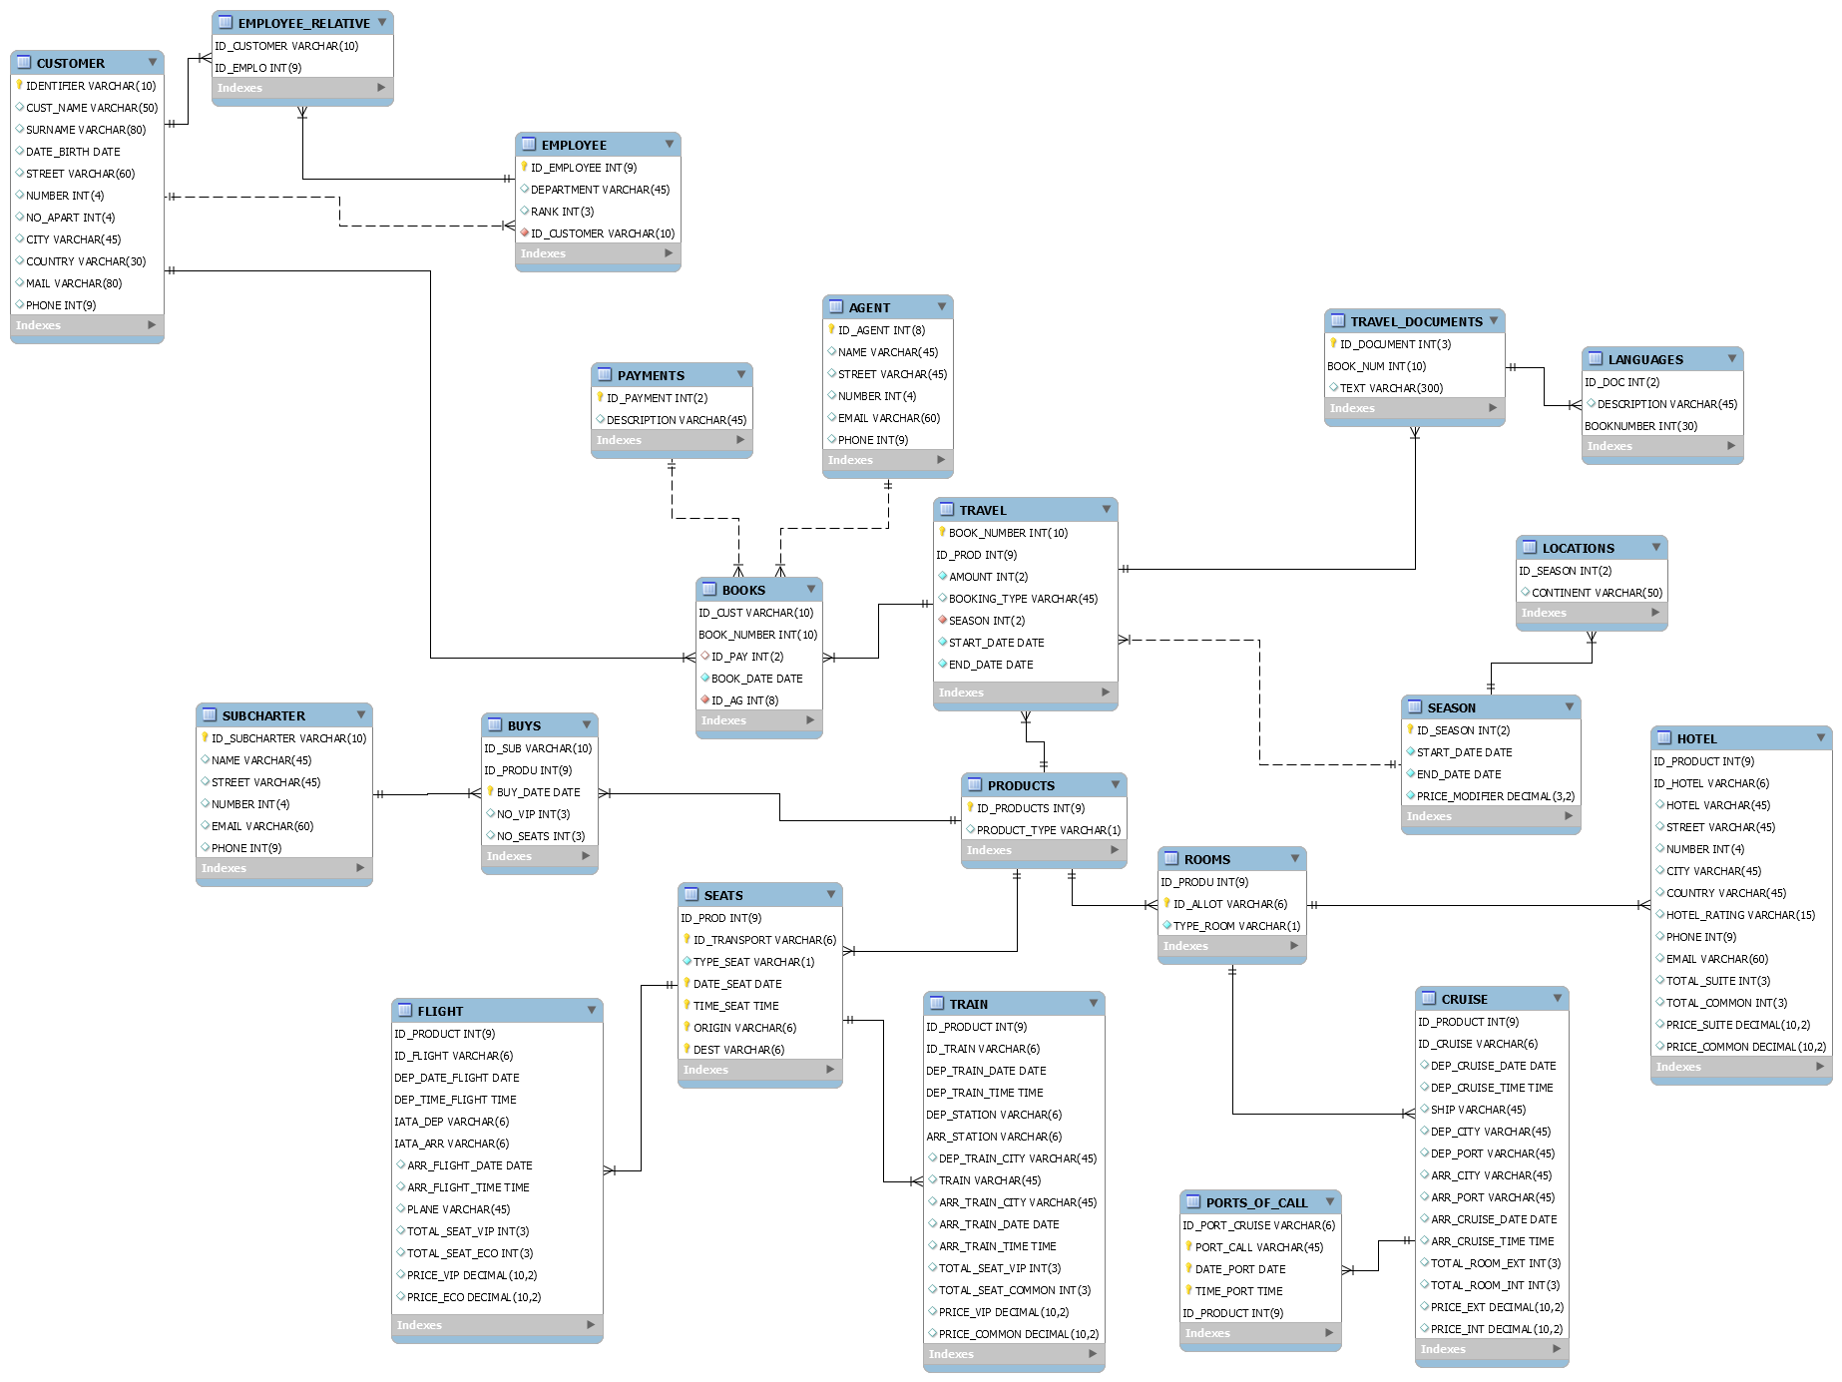
RELATIONAL MODEL IN MySQL

Slide 6
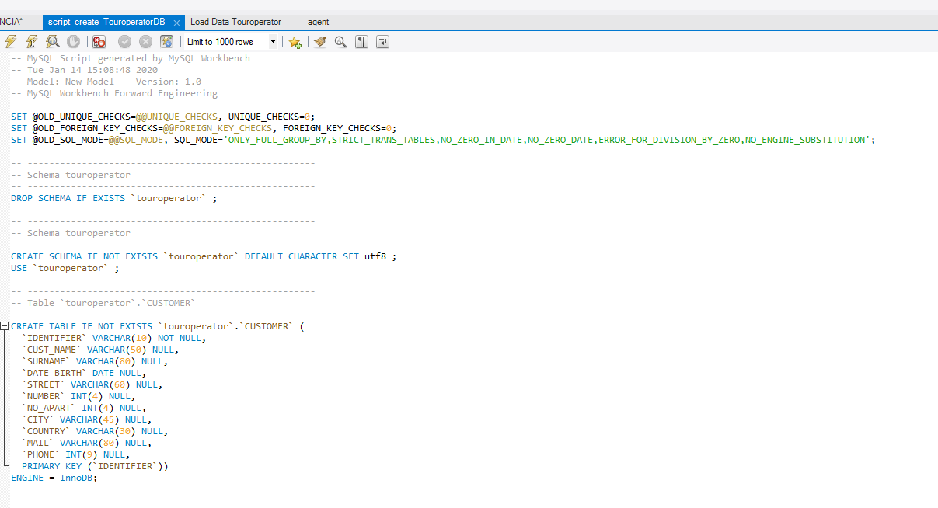
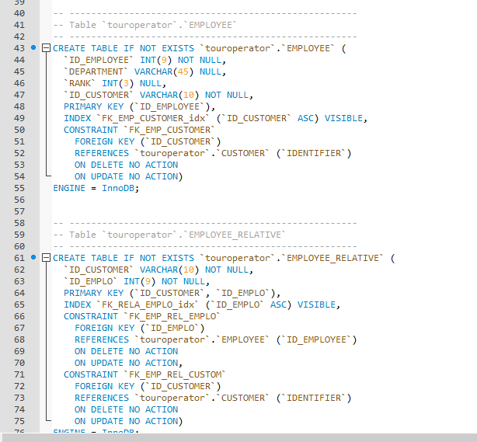
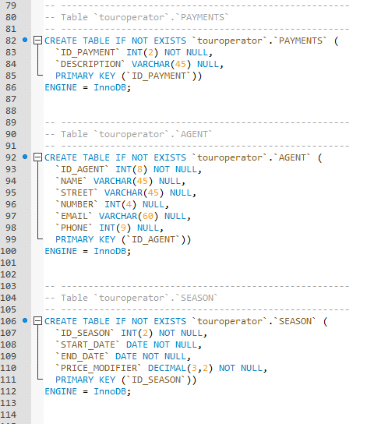
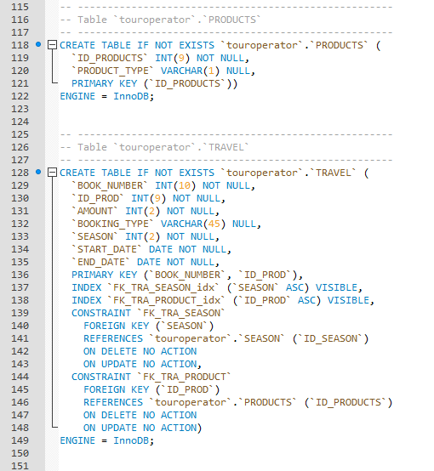
THE SQL SCRIPT
Generate atomatically the script importing the model using the reverse engineer to create a SQL script with the different tables of our database.
* For more information, consult the attached document script_create_touroperator.cql

Slide 7
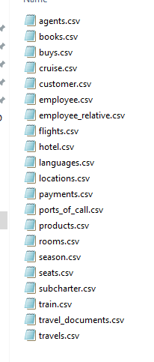
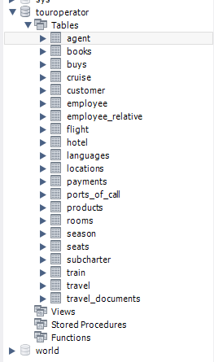
Opening the script SQL Document and executing the code, the database is already created (without data).
To check the relational model of our database we created a CSV file with data information invented by us:

Slide 8
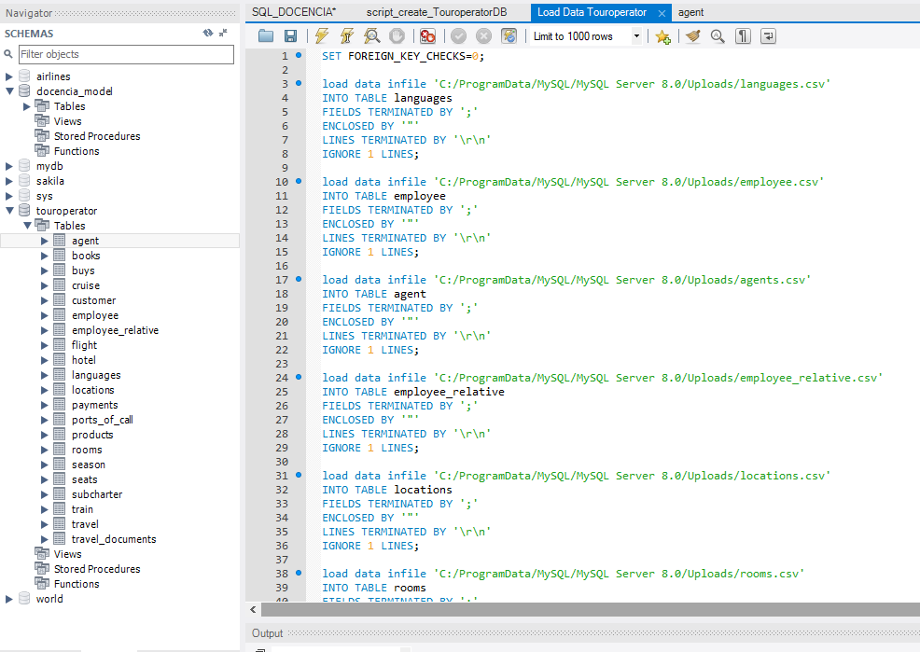
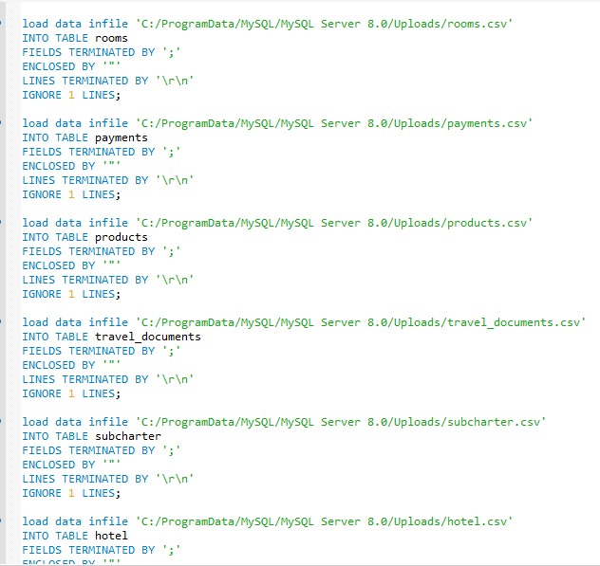
Load all data file.csv with the code following:
* For more information, consult the attached document load data touroperator.cql

Slide 9
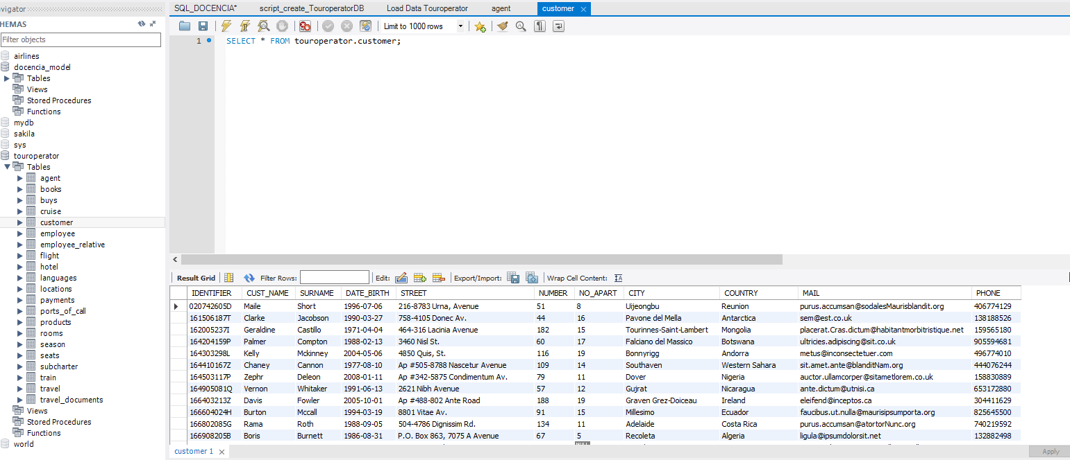
Create the table of customer .
Do that for each table of the Database.

Slide 10
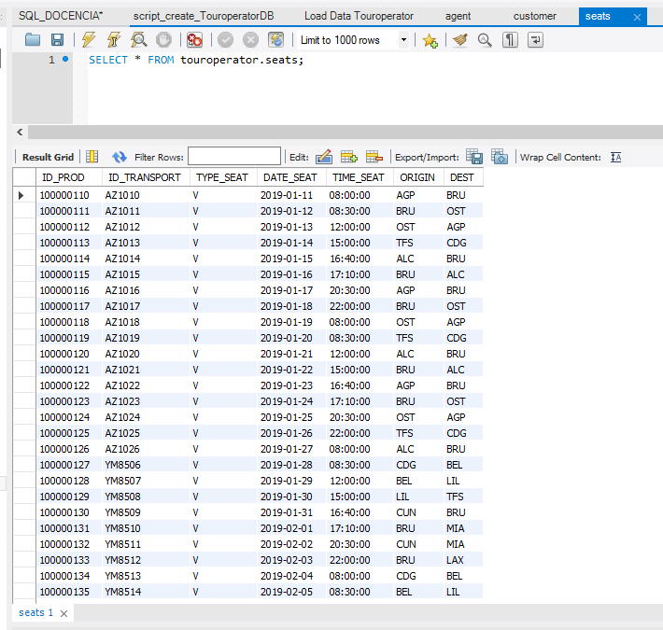
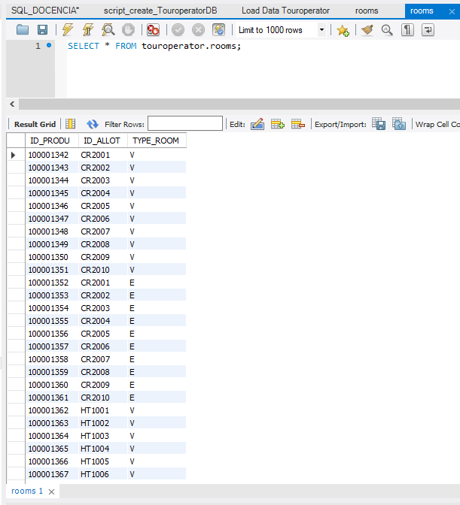
Seats table
Rooms table

